Slide 1
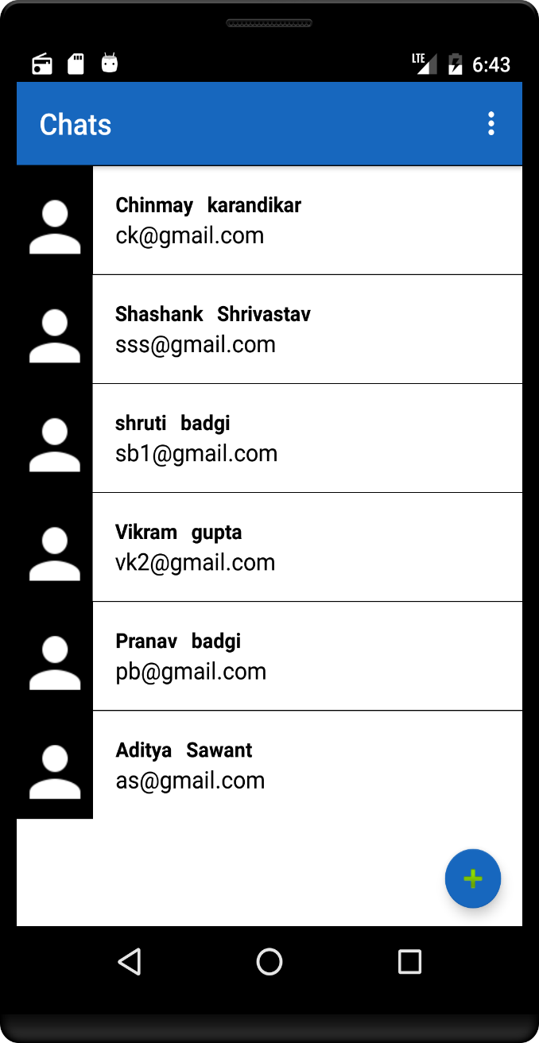
Secured Chat app
Presented by
Kamlesh Verma
Pranav Badgi
Shreyash Karandikar
Vikram Gupta

Slide 2
Contents
Introduction
Scope
System Architecture
Model Implemented
Use Case Diagram
E-R Diagram
Activity Diagram
Features
Advantages
Disadvantages
System Requirements

Slide 3
INTRODUCTION
Chat may refer to any kind of communication over the Internet that offers a real-time transmission of text messages from sender to receiver. Chat messages are generally short in order to enable other participants to respond quickly. Thereby, a feeling similar to a spoken conversation is created, which distinguishes chatting from other text-based online communication forms such as Internet forums and email.

Slide 4
FM Radio

Slide 5
Scope
Communicating with people on a daily basis has become an essential part of our day-to-day lives. Many ChatApps are available to fulfill the needs but many don’t provide the security or privacy required.
We have a solution!
We are creating an app that not only hides the Chats but the Application itself. Creating a more secured app to use.

Slide 6
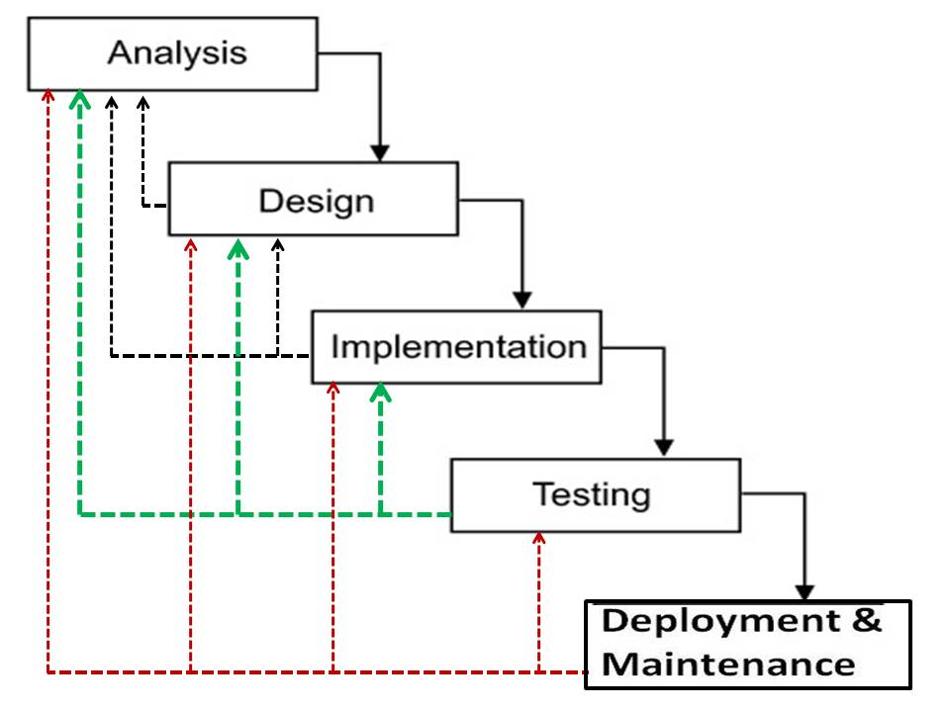
Model
Waterfall Model

Slide 7
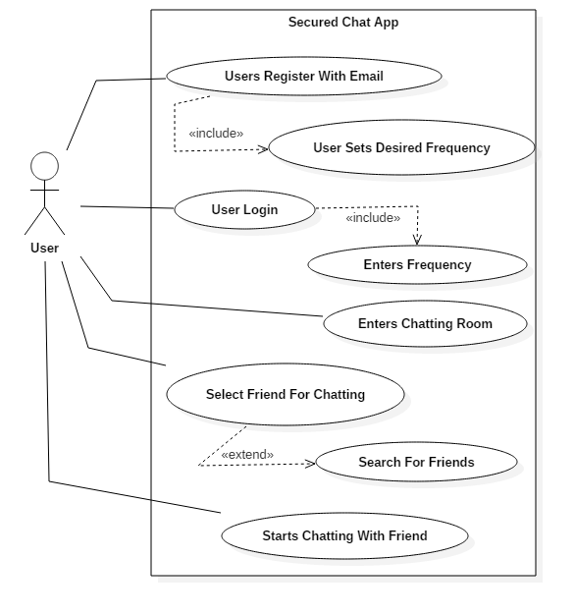
USE CASE DIAGRAM

Slide 8
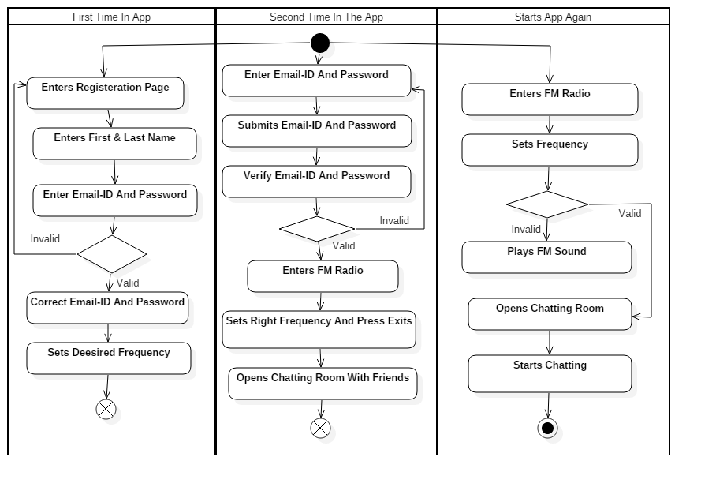
Activity Diagram

Slide 9
FEATURES
Hidden Application.
App with Internet Connectivity (Global).
Hidden Chat Rooms.
FM Interface.
End to End Encryption.
The ChatApp files not visible in File Manager.

Slide 10
ADVANTAGES
App cannot be opened except the user.
Icon used is FM Radio Icon
More Privacy.
Messages sent and received can only be seen in the App not in File Manager.
Chats are not accessible without Internet.

Slide 11
System Requirements
1.2GHz Processor
512 RAM
Android 5.0 above
10MB Free Space

Slide 12
THANK YOU

